Slide 1

HTML Tables
1 LYGIS
2021

Slide 2
Šiandien išmoksite
HTML Tables
Table Basics
01
04
Tables Advanced
02
05
03
06

Slide 3
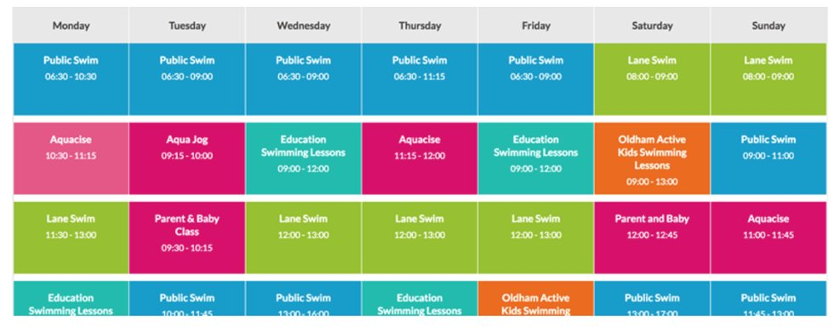
HTML Tables
HTML Tables
A table is a structured set of data made up of rows and columns (tabular data).

Slide 4
HTML Tables: <tag>
HTML Tables
<table></table> – initial wrapper for all table.
<tr></tr> – table row, describes how many rows will be in a table (a child of <table>).
<td></td> – table data, describes columns (a child of <tr>).
<th></th> – table header, describes element. Special cell that goes at the start of a row or column and defines the type of data that row or column contains.

Slide 5

HTML Tables
Užduotis nr. 1
Build a simple table with:
Tags <table>, <tr>, <td>;
Include 3 rows;
Include for columns;
Content of cells, "hello world!"
To add styles.css download boilerplate from Trello.

Slide 6
HTML Tables: spanning multiple rows/columns
HTML Tables
<table>
<tr>
<th colspan="2">Some text</th>
</tr>
</table>
<table>
<tr>
<th rowspan="2">Some text</th>
</tr>
</table>

Slide 7
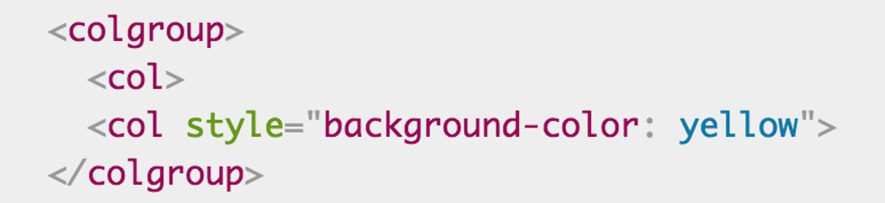
HTML Tables: providing common styling
HTML Tables
<colgroup> – this tag is responsible for styling all columns at once. The children of <colgroup> is <col>.

Slide 8
HTML Tables
Užduotis nr. 2
First, make a local copy of our timetable.html file in a new directory on your local machine. The HTML contains the same table you saw above, minus the column styling information.
Add a <colgroup> element at the top of the table, just underneath the <table> tag, in which you can add your <col> elements (see the remaining steps below).
The first two columns need to be left unstyled.
Add a background color to the third column. The value for your style attribute is background-color: #97DB9A;
Set a separate width on the fourth column. The value for your style attribute is width: 42px;
Add a background color to the fifth column. The calue for your style attribute is background-color: #97DB9A;
Add a different background color plus a border to the sixth column, to signify that this is a special day and she's teaching a new class. The values for your style attribute are backrgound-color: #DCC48E; border: 4px solid #C1437A;
The last two days are free days, so just set them to no background color but a set width; the value for the style attribute is width: 42 px.

Slide 9
Naudinga informacija
HTML Tables

